Slide 1
Abstract algebra ch 8

Slide 2
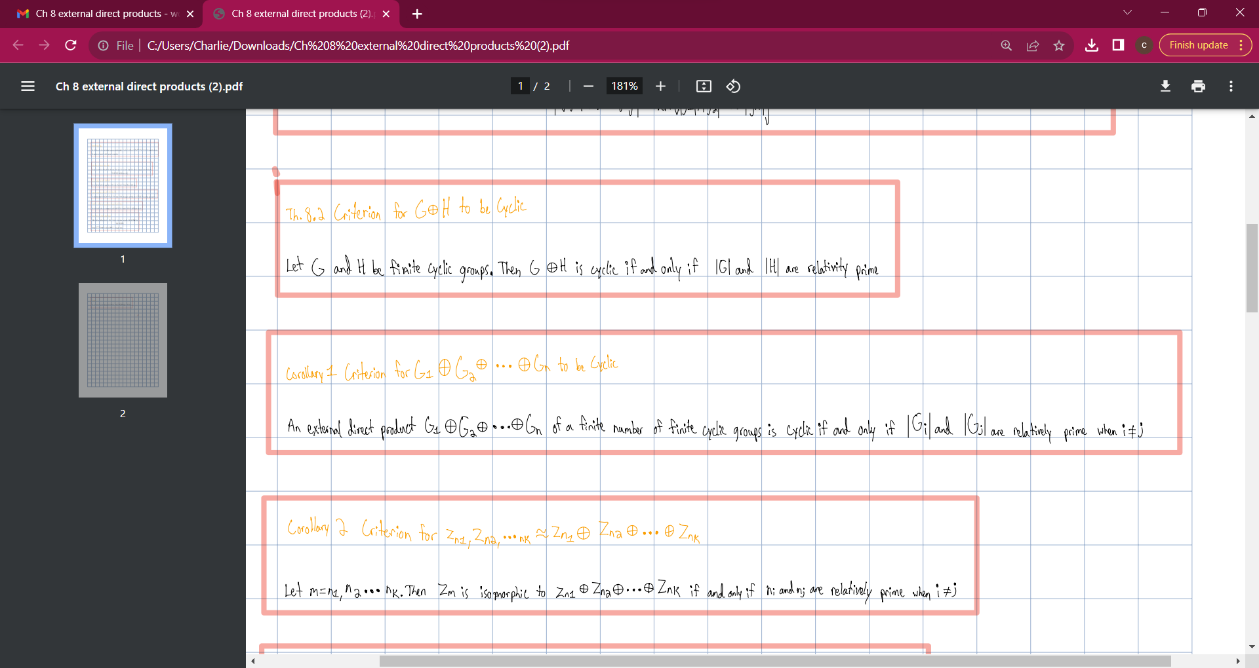

Slide 3
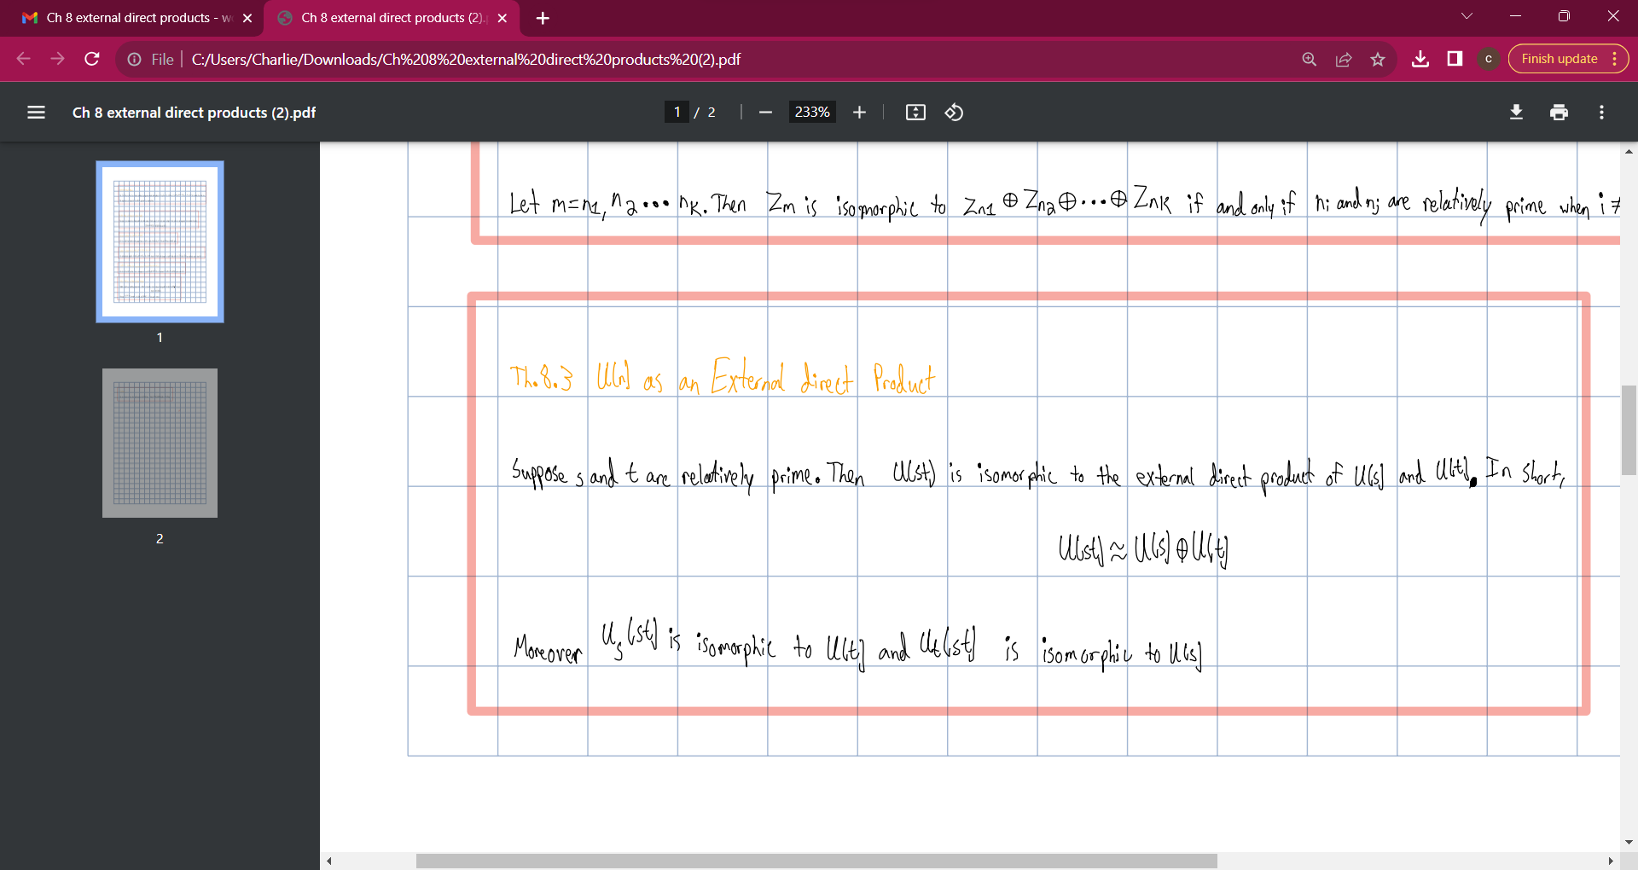

Slide 4
